Slide 1
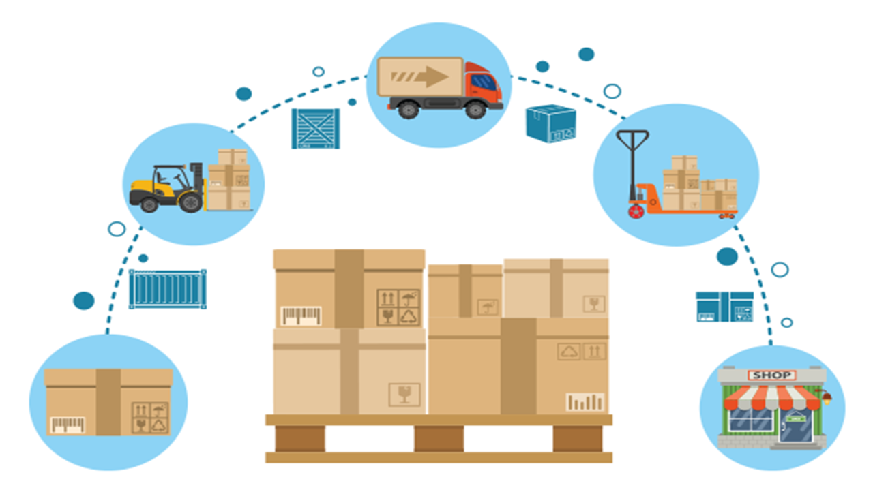
Package Manufacturing
Database System
Project Team 1:
Hans Huray
Priya Raul
Anjali Chitkara
Jaya Kalele
Nuli Bang
Notes:
-hans-

Slide 2
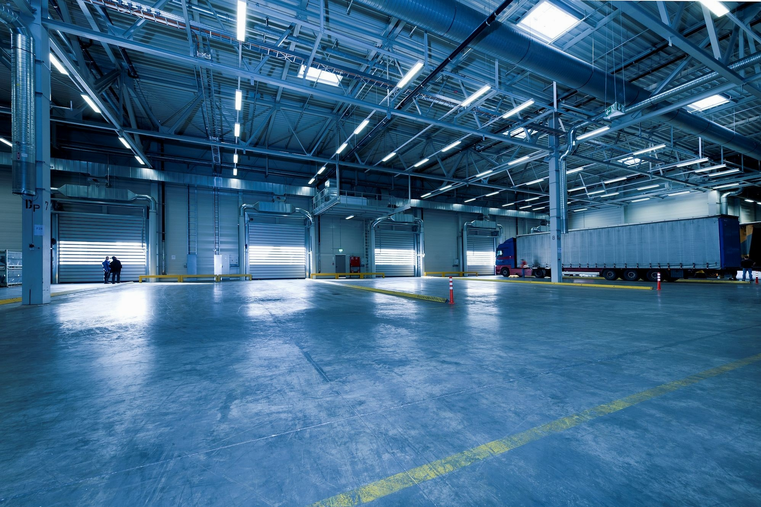
Agenda
Introduction
Problems Statement
Purpose
Workflow
ERD
Stakeholders And their use cases
Future improvements
Conclusion
Q & A
Notes:
-hans-

Slide 3

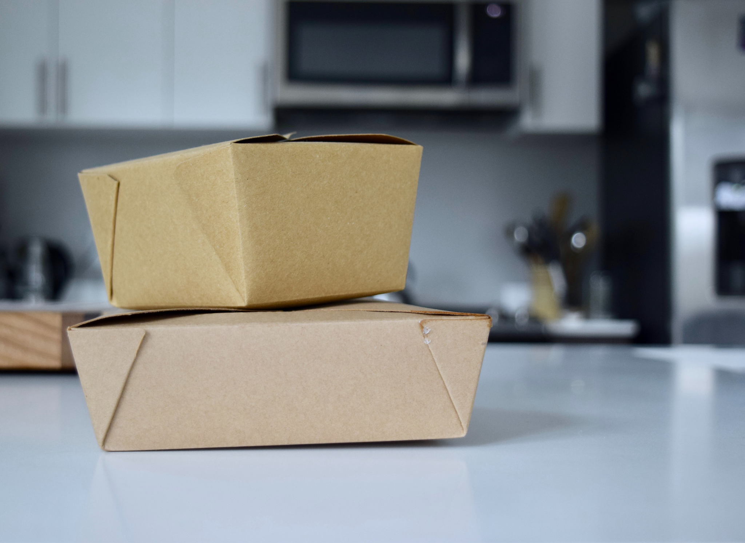
What is Packaging Manufacturing
Produce custom packaging through manufacturing process
Produce either custom packaging to order or stock presetted packaging to sell
The database that we designed is for packaging that are built to order with variety of customer’s specifications

Slide 4
Why Package Manufacturing
-Package Manufacturing, despite being a part of Manufacturing process. Is a service provider for clients. Certain standards must be met to fulfill Customer’s Expectations including:
Quantity
Quality
Time (Deadline)
Therefore every process through the manufacturing flow must be optimized to ensure these qualities are satisfied.
Notes:
-hans-

Slide 5
Problems addressed our design :
Several Issues that we found in existing package manufacturing process are:
Strict process schedule
Prioritization based on the deadlines
Numerous Data
Having a good visualization of the data leads to better analysis for quality improvement and order process time.
Notes:
-hans-
With this, there is a lot of data that needs to be managed. Having a database does not necessarily optimize the schedule per se but it definitely helps to better analyze the records to optimize every process in the workflow for better quality and faster process.

Slide 6
Purpose and views
Several examples that can be achieved by having this database:
Allow the staff of the manufacturing company to have report on orders placed by the customers
Create a descriptive report on material usage to enable forecasting raw materials needed for future orders
Create a descriptive report on possible sales opportunities for market analysis
Provide information on product reviews for quality improvements
Create a optimized schedule for each orders to fulfill deadlines
To summarize, the purpose of the database is to provide better data representation to have better communication with the users for drawing conclusions from the data .
Notes:
-hans-

Slide 7





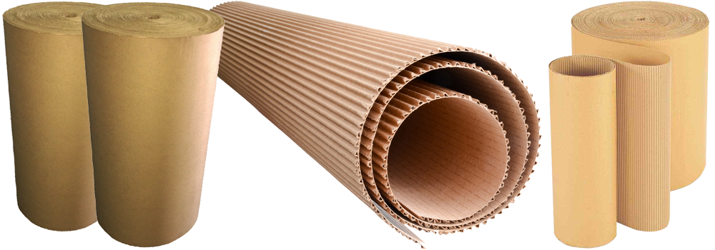
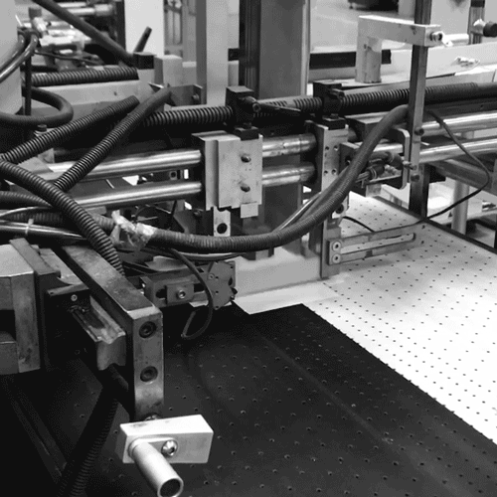

Package Manufacturing database System Workflow
Customer
Raw Material
Vendor
Warehouse

Slide 8
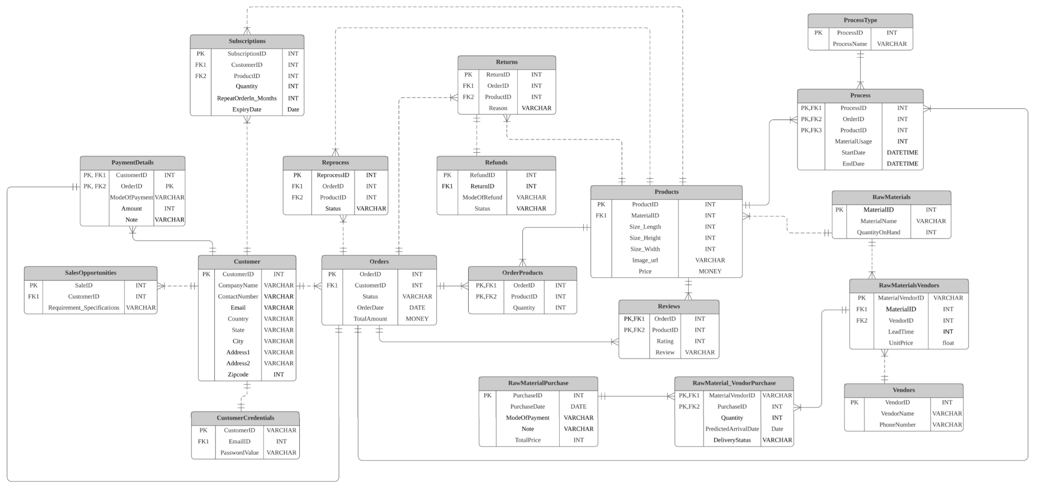
Entity Relationship Diagram
Notes:
priya

Slide 9
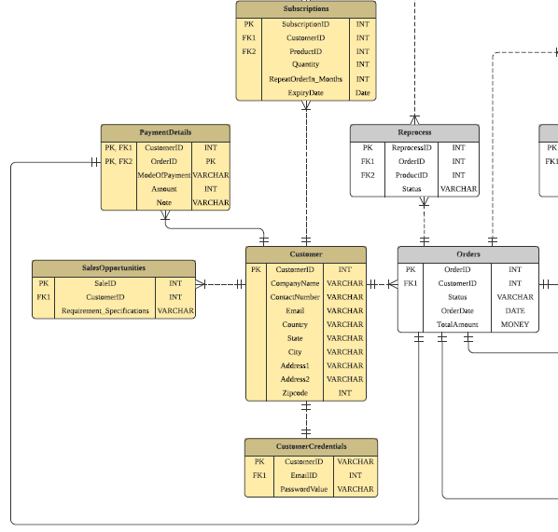
Customer
Customer entity will have details of customer
Customer credentials will get saved in CustomerCredentials
If customer have subscribed for a product that information will resides in subscription entity

Slide 10
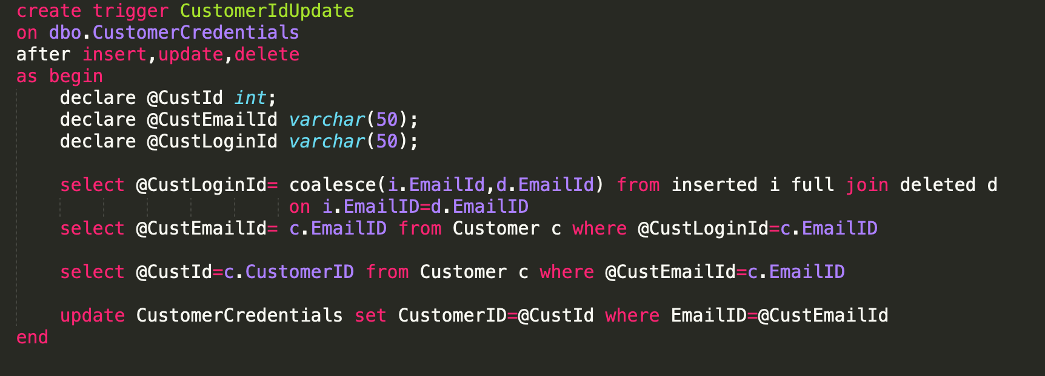
Table level Constraints
Trigger to get customer ID in CustomerCredentials table automatically

Slide 11
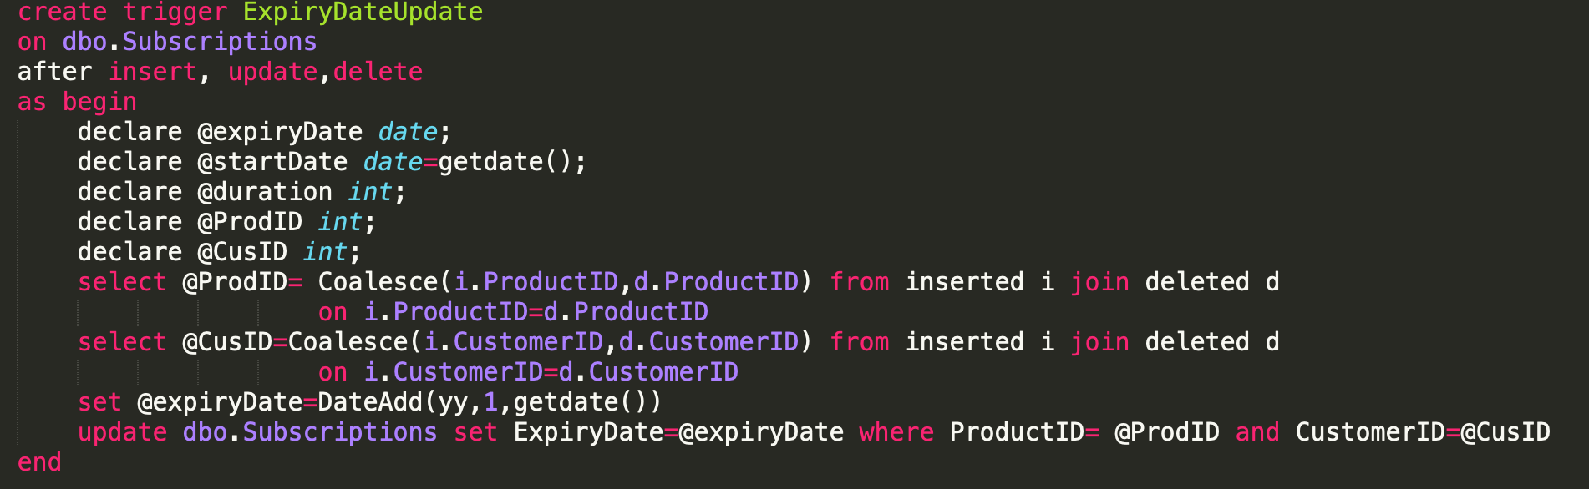
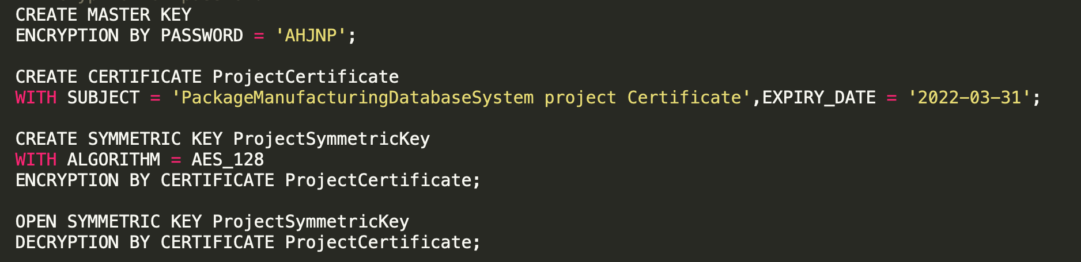
Trigger to automatically update expiry date in Subscriptions table
Encryption on password

Slide 12
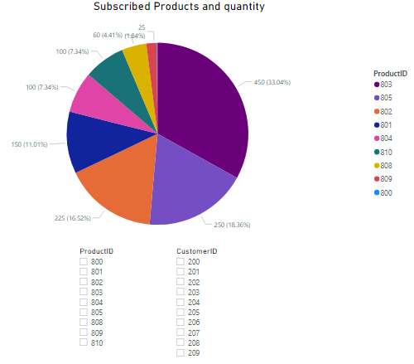
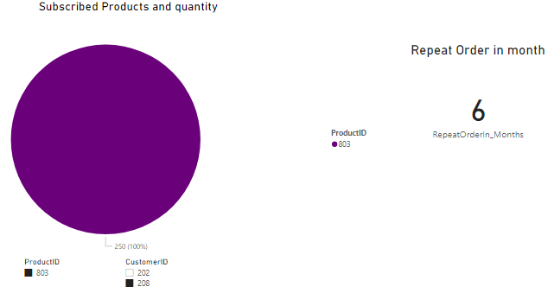

Slide 13
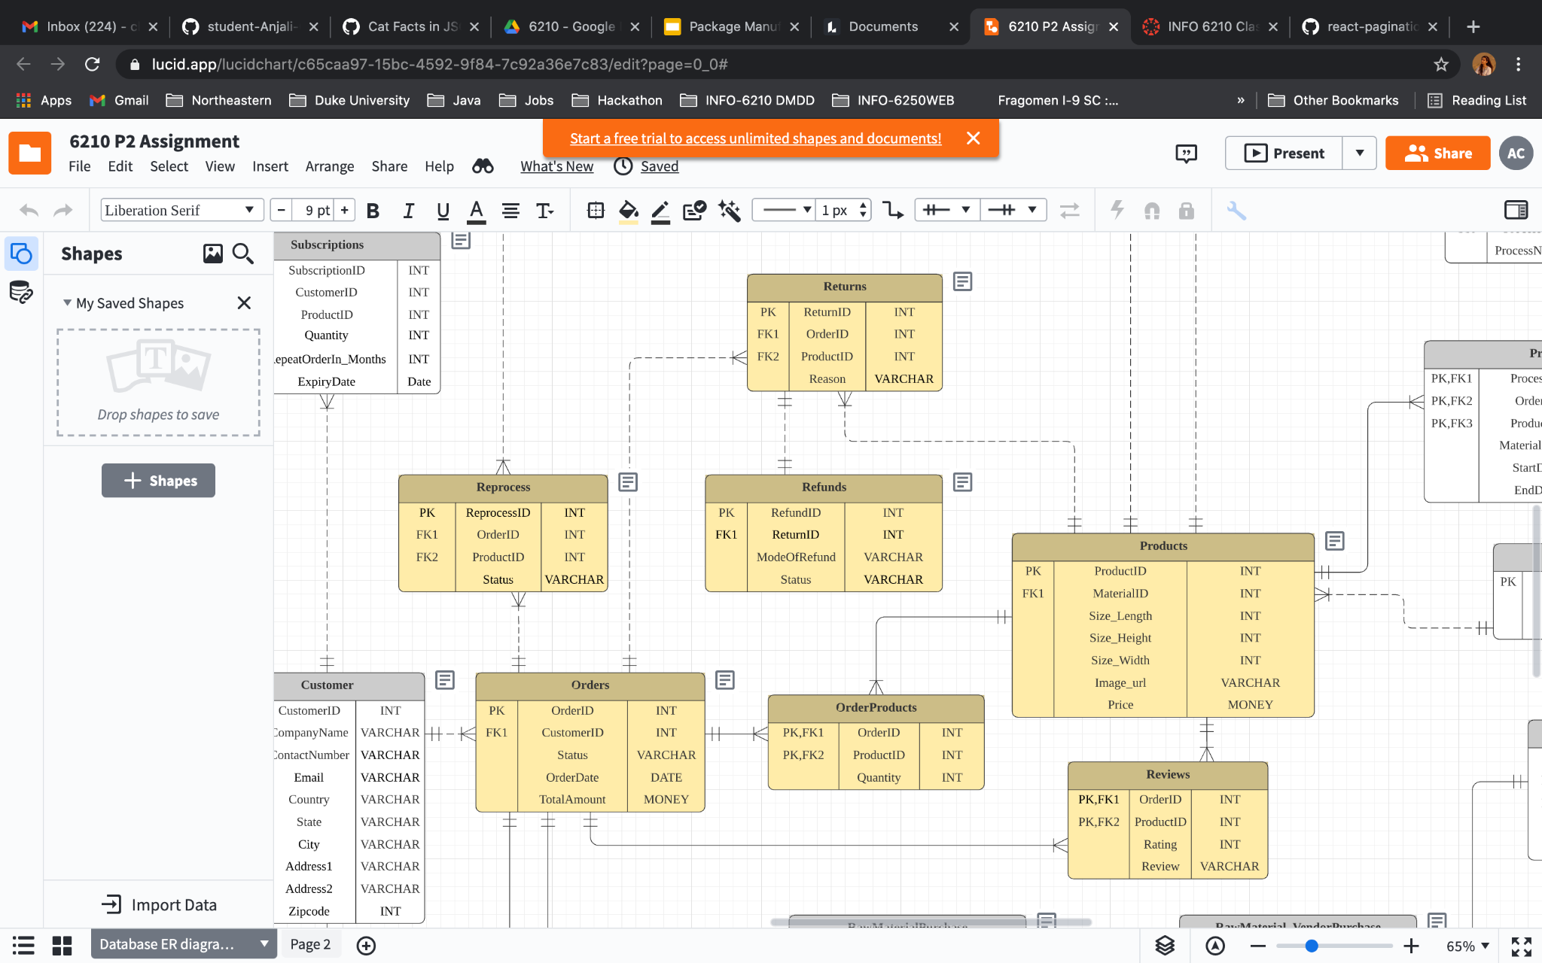
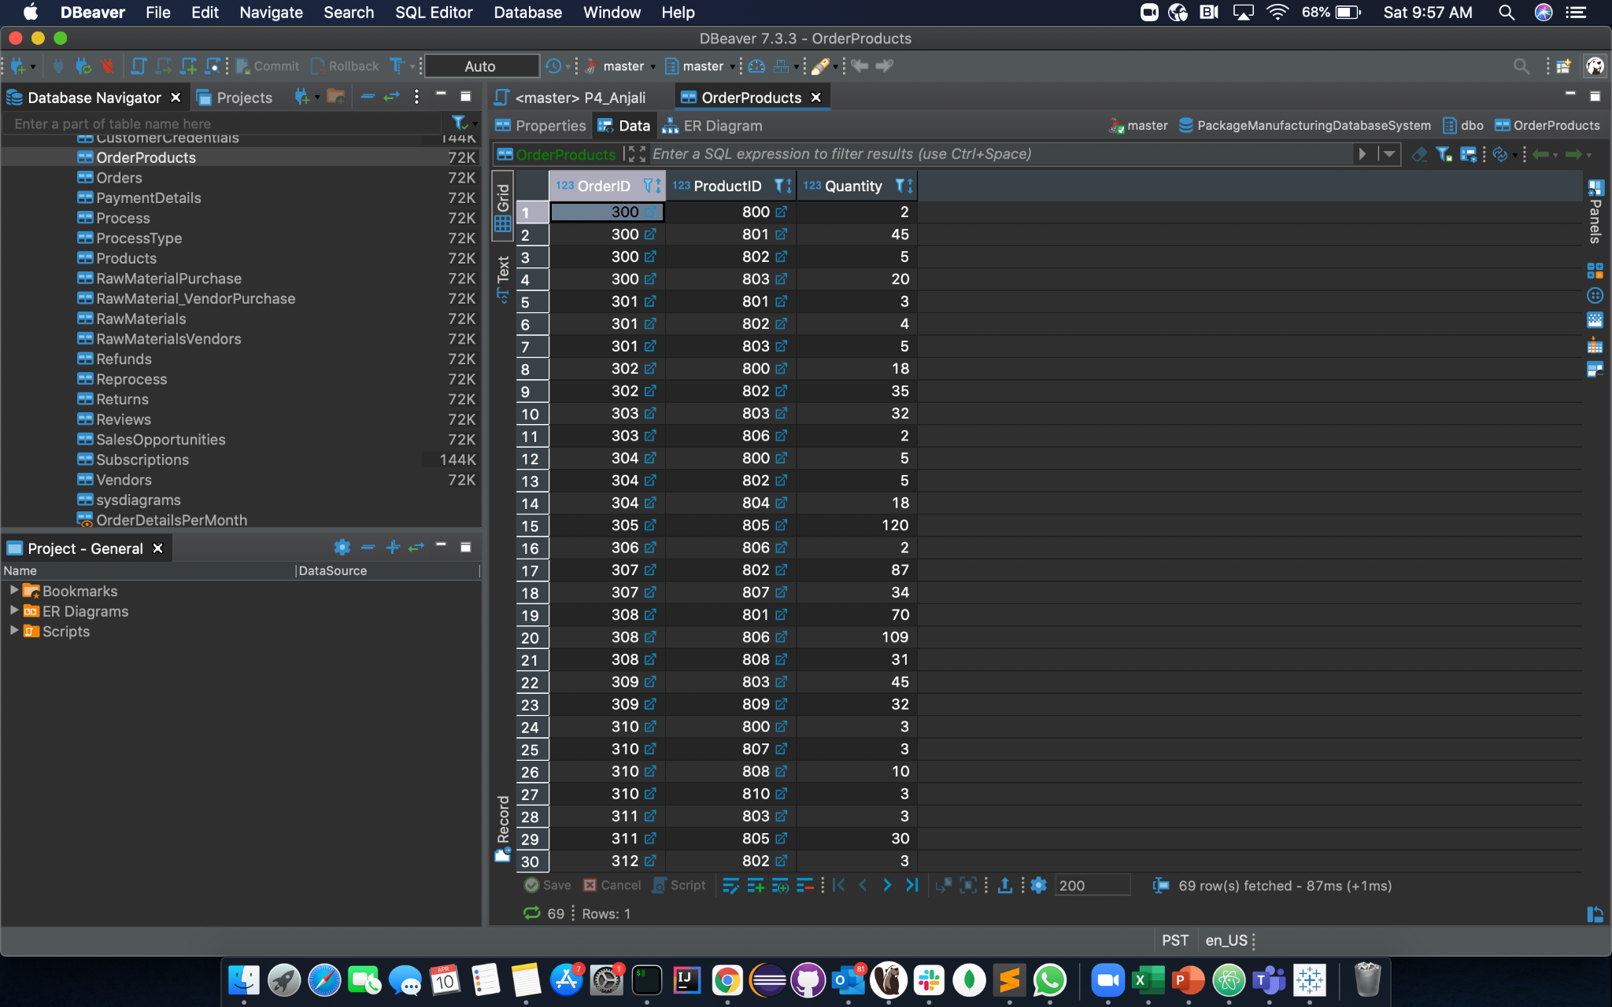
Orders and Products
-Orders keep record of the orders placed by the customers. It keeps track of the products ordered, their quantity and the total order amount.
-Reviews and Ratings for every product given by customers are also stored in our database.
-If a customer does not like the product, they can Return or request for Reprocessing. In the case of Reprocessing, a replacement order is created for that customer.
-If a product is Returned, a Refund is issued for that Order.

Slide 14
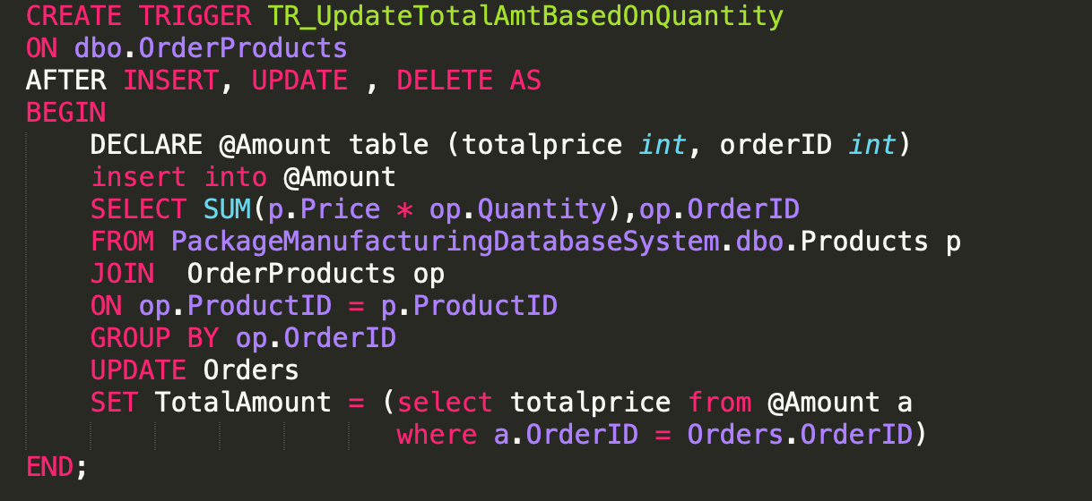
Trigger to compute Total amount in Orders

Slide 15
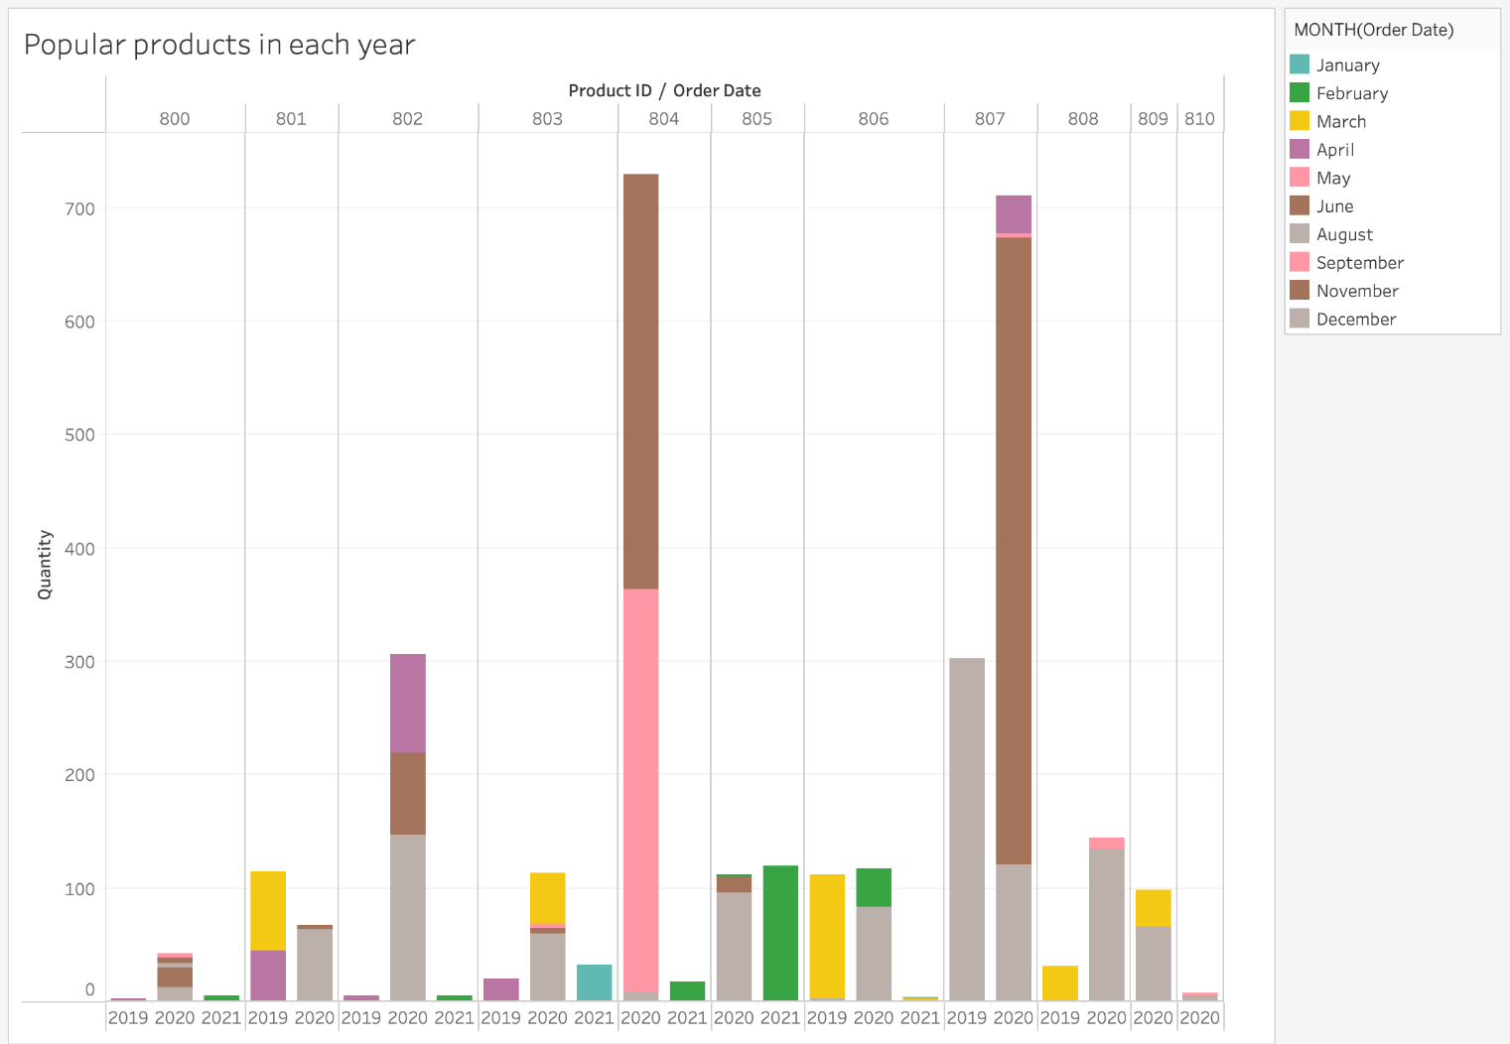

Slide 16
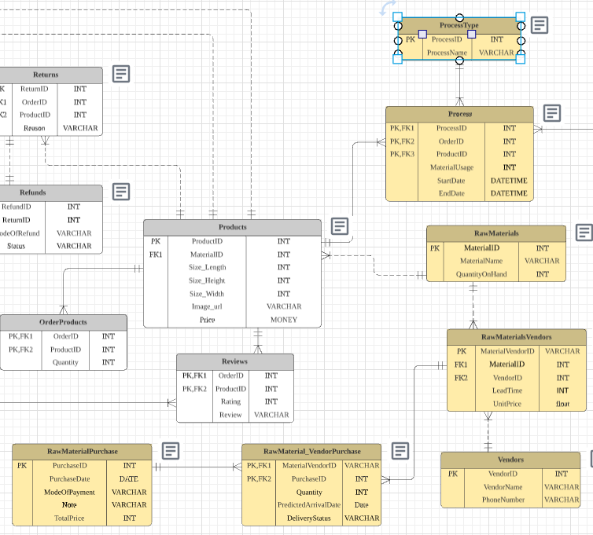
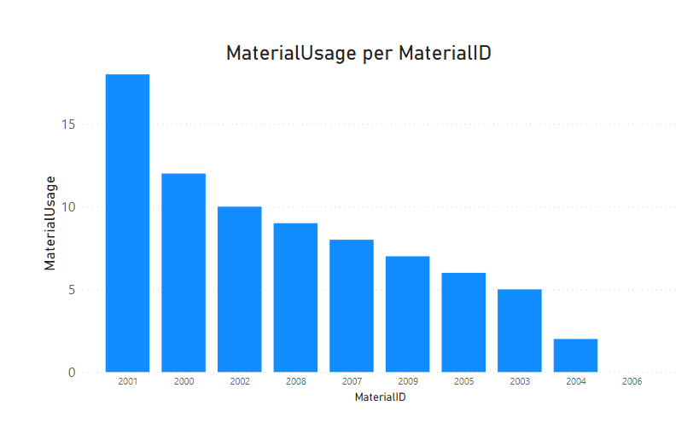
Process and Raw Materials
A typical process that an item in the warehouse goes through is :
PRINTING → LAMINATION → BAG/BOX MAKING → QUALITY CHECK
Start & End time of each process is stored for Process scheduling.
Material Usage : to keep track of the Material on hand.
Records the outgoing and incoming stock of ready for use Raw Material
Outgoing: Material Usage that is used for process
Incoming: Raw Material that is purchased but not yet delivered
Compare prices and lead time from list of material vendors
Keep track of incoming raw materials that is not yet delivered

Slide 17
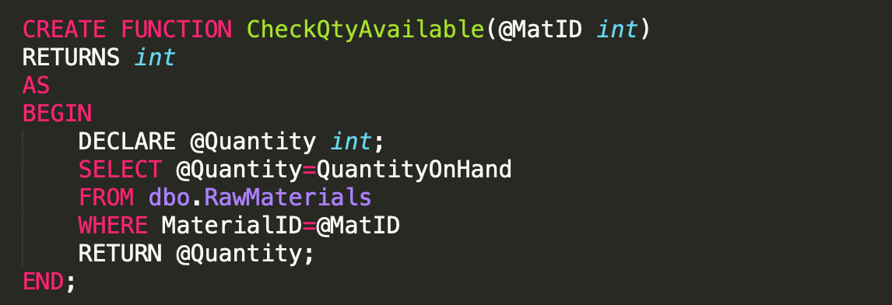
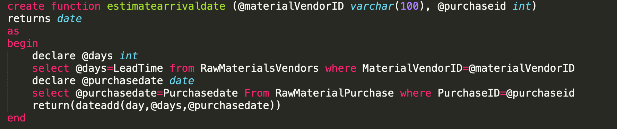
Functions and Constraints
Functions to compute Quantity on hand & estimated arrival date for raw materials

Slide 18
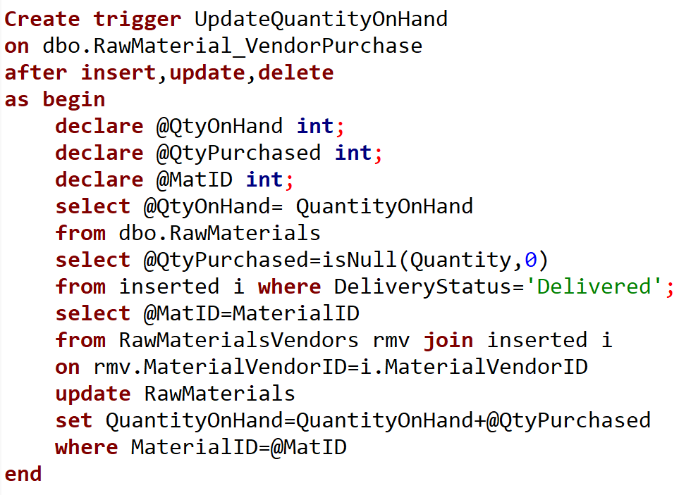
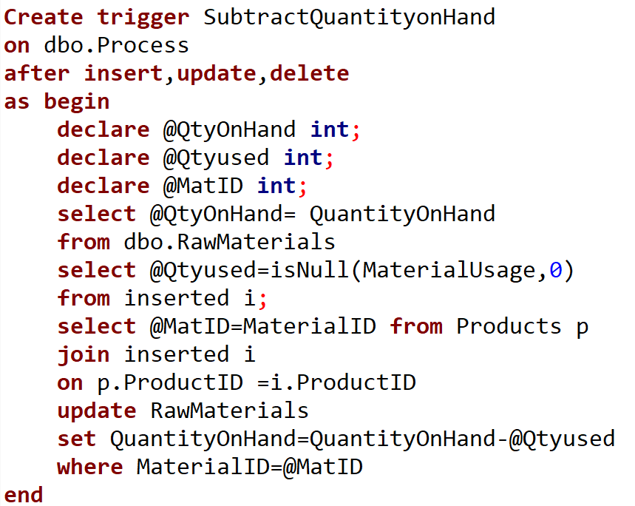
Triggers

Slide 19
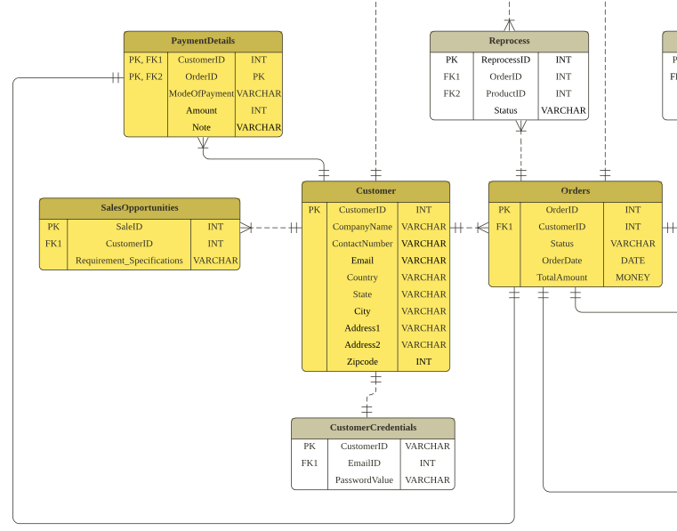
Payments &
SalesOpportunities
Notes:
Claire - (silde:18 - 21 2m30sec)
let me introduce the sales opportunities and payment detail tables.
These two tables work to store data between the customer and order.
First, Salesopportunities table is
for storing future sales chances.
Before the contract between the customer and us, we note the summary of the customer’s future requirments and specification here
to make a deal in the future.
And on PaymentDetail table,
we store literally all the payment details
from the orders.
It contains the mod of payment and note additionally.

Slide 20
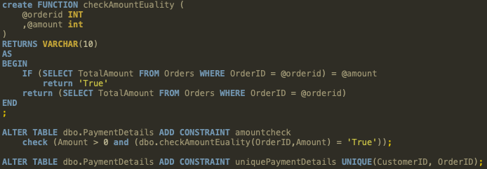
Function and Constraints
Notes:
Claire - here, we can see the function and constraints for these tables.
the amount in the order table and paymentdetail table should be same for the data consistency.
For this, we’ve created the function
to check the constraint and applied it on the payment table.
Plus, amount should be more than 0.
Lastly, the payment for one order should be one, so we put the constraint for that as well.

Slide 21
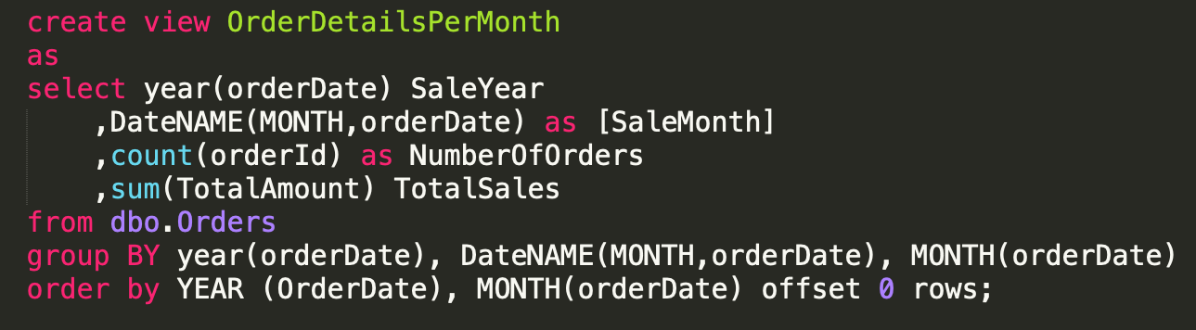
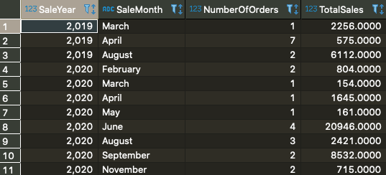
Report 1 : OrderDetailsPerMonth
Purpose : To report total order per month
Notes:
Claire - Let me introduce two views
which can help analysing and reporting the data easily.
First, This is the view named orderDetailsPerMonth.
From this view, we can see the summarized data of total order and sales amount by month.
I put the last sentence to sort the result by appropriate order.

Slide 22
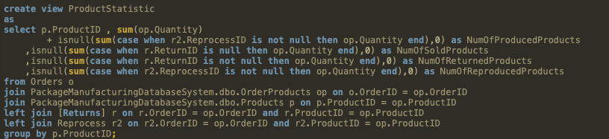
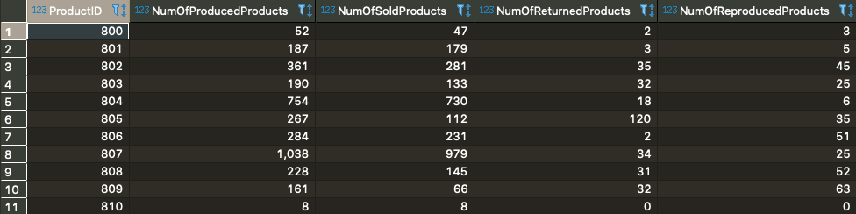
Report 2 : Product Statistics
Notes:
Claire - second, this is the other view of product statistics. From this, we can see all the data of processed products. We can see how much product we processed, sold, returned and reproduced.
Also We can confirm which products are popular
or having problems oftenly
so we can improve them not to be returned and reproduced in future processes.

Slide 23
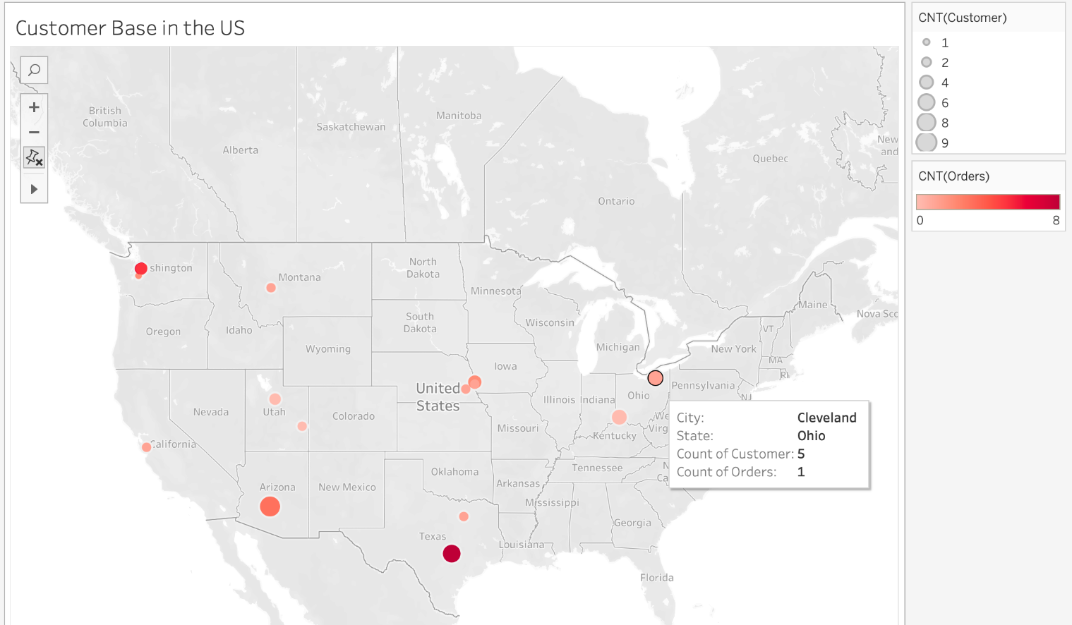
Conclusion and possible future improvements
The database is not limited to create only one report but different reports representing different data that is needed for different situations which will be crucial in data analysis for quality control and improvement
Future Improvements:
automate a database system to optimize process and raw material forecasting based on customer orders trend and deadlines
Create a Delivery logistics plan for order delivery to customers
Notes:
Hans

Slide 24

Thank you
Notes:
Hans

Slide 25


